Slide 1

Radioactive Random Number Generator
Programming Embedded Systems Spring 2021
Kayleigh Post, Kevin McBrien, Josh Pitts,
Adam Lothridge, John McMeen
Notes:
John

Slide 2
Overview
How random numbers are created
Why random numbers are important
Our hardware and software
Build notes
Future work
Notes:
John
Use in cryptography, so security applications
Test data for applications
Simulating complex phenomenon that require source of entropy
All the way from biological simulations to economic
Statistics – selecting random samples

Slide 3
What makes a random number generator random?
It’s difficult to tell a computer to produce something abstract
Pseudorandom numbers are usually seeded with the time elapsed since January 1st, 1970, but not always
Truly random number need a source of entropy
They key to randomness is being hard to predict
Notes:
Adam
“random” is an abstract concept, difficult to tell a computer to produce something abstract
Computers are deterministic, meaning they’re just following orders; it’s going to do the same thing every time because it’s just following directions
Pseudo random number generators are deterministic algorithms, and we judge how “random” they are by how long it takes them to start working in a loop and repeating themselves
Mersenne twister
The best way we can do this is find something with entropy and use this as a source of randomness
Temp in this room is not 70 degrees, it’s 70 and an infinitesimal number of decimal places, constantly changing
We can predict how much radiation this marble will give off, but we can’t predict when a radioactive event will occur
We try to find things that are hard to predict
https://www.random.org/randomness/#:~:text=Random%20numbers%20are%20useful%20for,samples%20from%20larger%20data%20sets.

Slide 4
What are the applications of having truly random numbers?
Cryptography
Security applications
Simulating complex phenomenon
Selecting random samples for statistical analysis
Notes:
Adam
Use in cryptography, so security applications
Test data for applications
Simulating complex phenomenon that require source of entropy
All the way from biological simulations to economic
Statistics – selecting random samples

Slide 5
HRNG Semester Project
Uranium glass marbles are radioactivity source
Designed and 3d printed our own enclosure
Developed our own algorithm based around Geiger board and Arduino Nano interrupts
Developed a user interface using Nextion display
Notes:
John

Slide 6
Uranium Marbles
Ultraviolet (UV) light emitting diodes (LED), black lights, illuminate uranium glass marbles
Uranium fluoresces green because UV light excites uranium electrons above the ground state, which creates photons as the electrons transition back to ground state
The UV lights blink when the Geiger counter signals a radioactive event
Lights are cosmetic and do not affect random numbers
Notes:
Josh

Slide 7
Custom Enclosure
Started with predecessor design, but too many modifications were needed
Learned computer aided drafting (CAD) and Dremel Slicing software to design model from scratch
Printed using departmental Dremel Digilab 3D45 printers
Notes:
Kevin

Slide 8
Nextion HMI
User interface is a 3.5” Nextion Human Machine Interface (HMI) touch screen
Communicates with Arduino Nano using a serial interface, kind of like USB device
Graphical user interface (GUI) created using Nextion Editor and linking code to screen
Notes:
Adam

Slide 9
Arduino and Geiger Counter
The uranium glass marbles are a source of radioactivity
A prebuilt Geiger counter board was used to detect radioactive events
A signal is sent from the Geiger counter to the Arduino, telling it to register a radioactive event
Because we can’t predict when a radioactive event will happen, these events can be used as a source of entropy
Notes:
Kayleigh

Slide 10
Algorithm Design
Each time a radioactive event occurs, the device will see how many microseconds have elapsed since the device was powered on.
Microseconds are returned from the board in 4 microsecond intervals, so we divide the number by 4.
The board then sees if the number is even or odd by using a mod2 function which divides by 2 and takes remainder.
This will always generate a 0 or 1 remainder.
Those 0’s and 1’s are used to created a bit stream
Notes:
Kayleigh

Slide 11
Algorithm Design cont.
This is equivalent to someone spinning a coin 250,000 times a second and then telling them to stop!
Then taking heads or tails, 0 or 1, and using it to create a number
Notes:
Kayleigh
The coin is even or odd time, and the person telling them to stop is a gamma ray or beta particle

Slide 12
Frequently Asked Questions

Slide 13
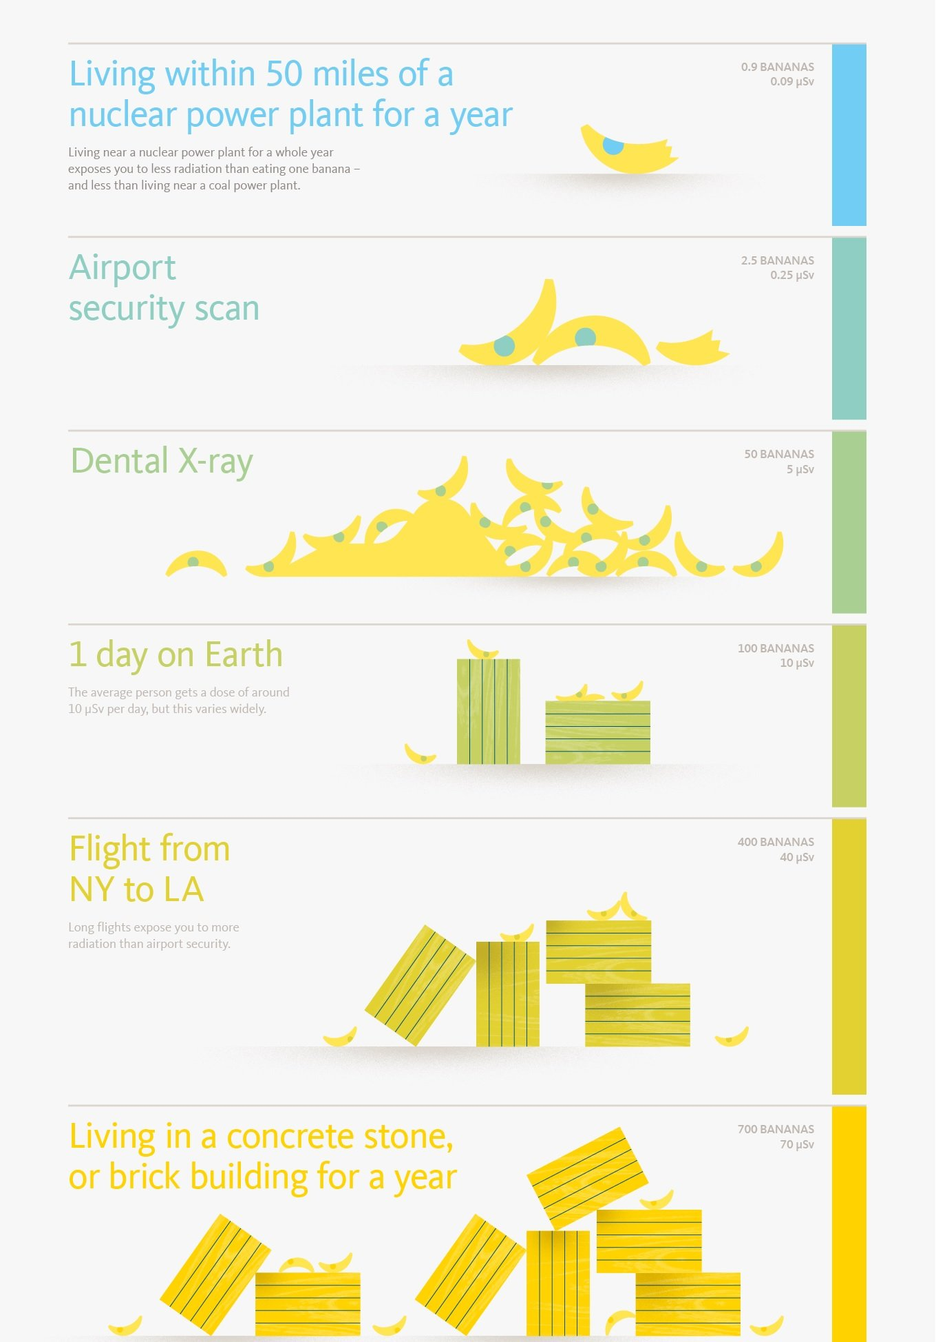
Is it safe???
Notes:
Kayleigh and John
You receive a certain amount of radiation every day just from buildings, the sun, food… it’s everywhere
Uranium glass contains trace amounts of uranium
Safe to the touch, can’t leach out of the glass
Produces mostly alpha particles, but does produce weak beta and gamma, which is what is being detected
That’s why it has to be so close to the Geiger muller tube
Uranium follows the inverse square law, so the farther away you are, the safer you are
It’s not a linear drop-off, it’s exponential
https://www.ncbi.nlm.nih.gov/pmc/articles/PMC6037814/
Paper will shield alpha, aluminum will shield beta, lead shields gamma

Slide 14
How random is it?
Since radioactive events are unpredictable, it is difficult to predict when a 0 or 1 will be chosen, and are uniformly distributed over [0,1]
In Streaming Mode, the 0’s and 1’s are combined to create an 8-bit number. The bits will average out to be half 0 and half 1 in the final number. This creates a normal distribution from [0 – 255]
In Dice Mode, the number is generated using the same method, except the final number is put through another mod
function. This makes the distribution closer to uniform
but not perfect.
Notes:
John

Slide 15
How fast can it generate numbers?
The device requires a radioactive event to chose a 0 or 1 for the 8-bit number generated.
Providing a more powerful radioactive source would increase the rate at which the bit stream is filled for each random number.
A more powerful source would allow the device to generate larger numbers, faster, such as 16-, 32-, and 64-bit numbers.
Notes:
Adam and John

Slide 16
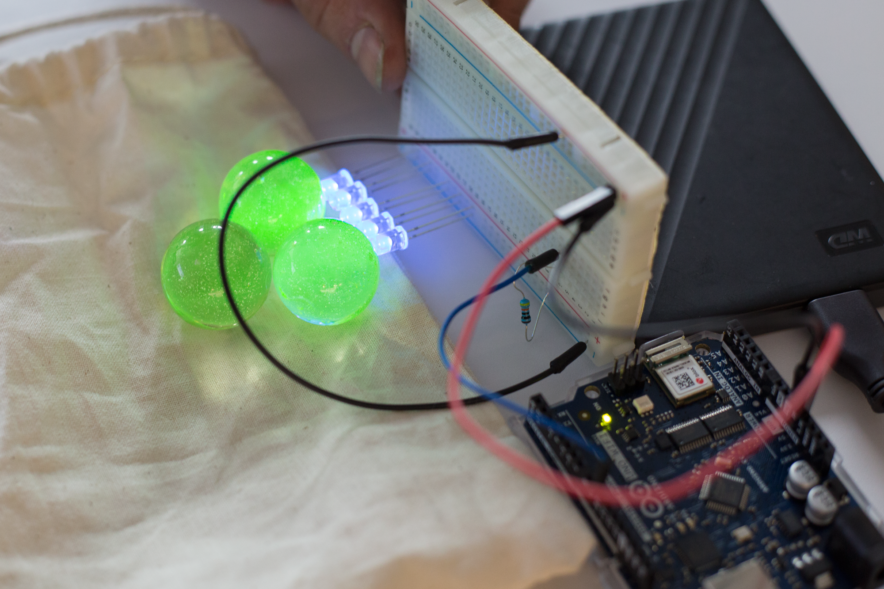
Progress Photos

Slide 17
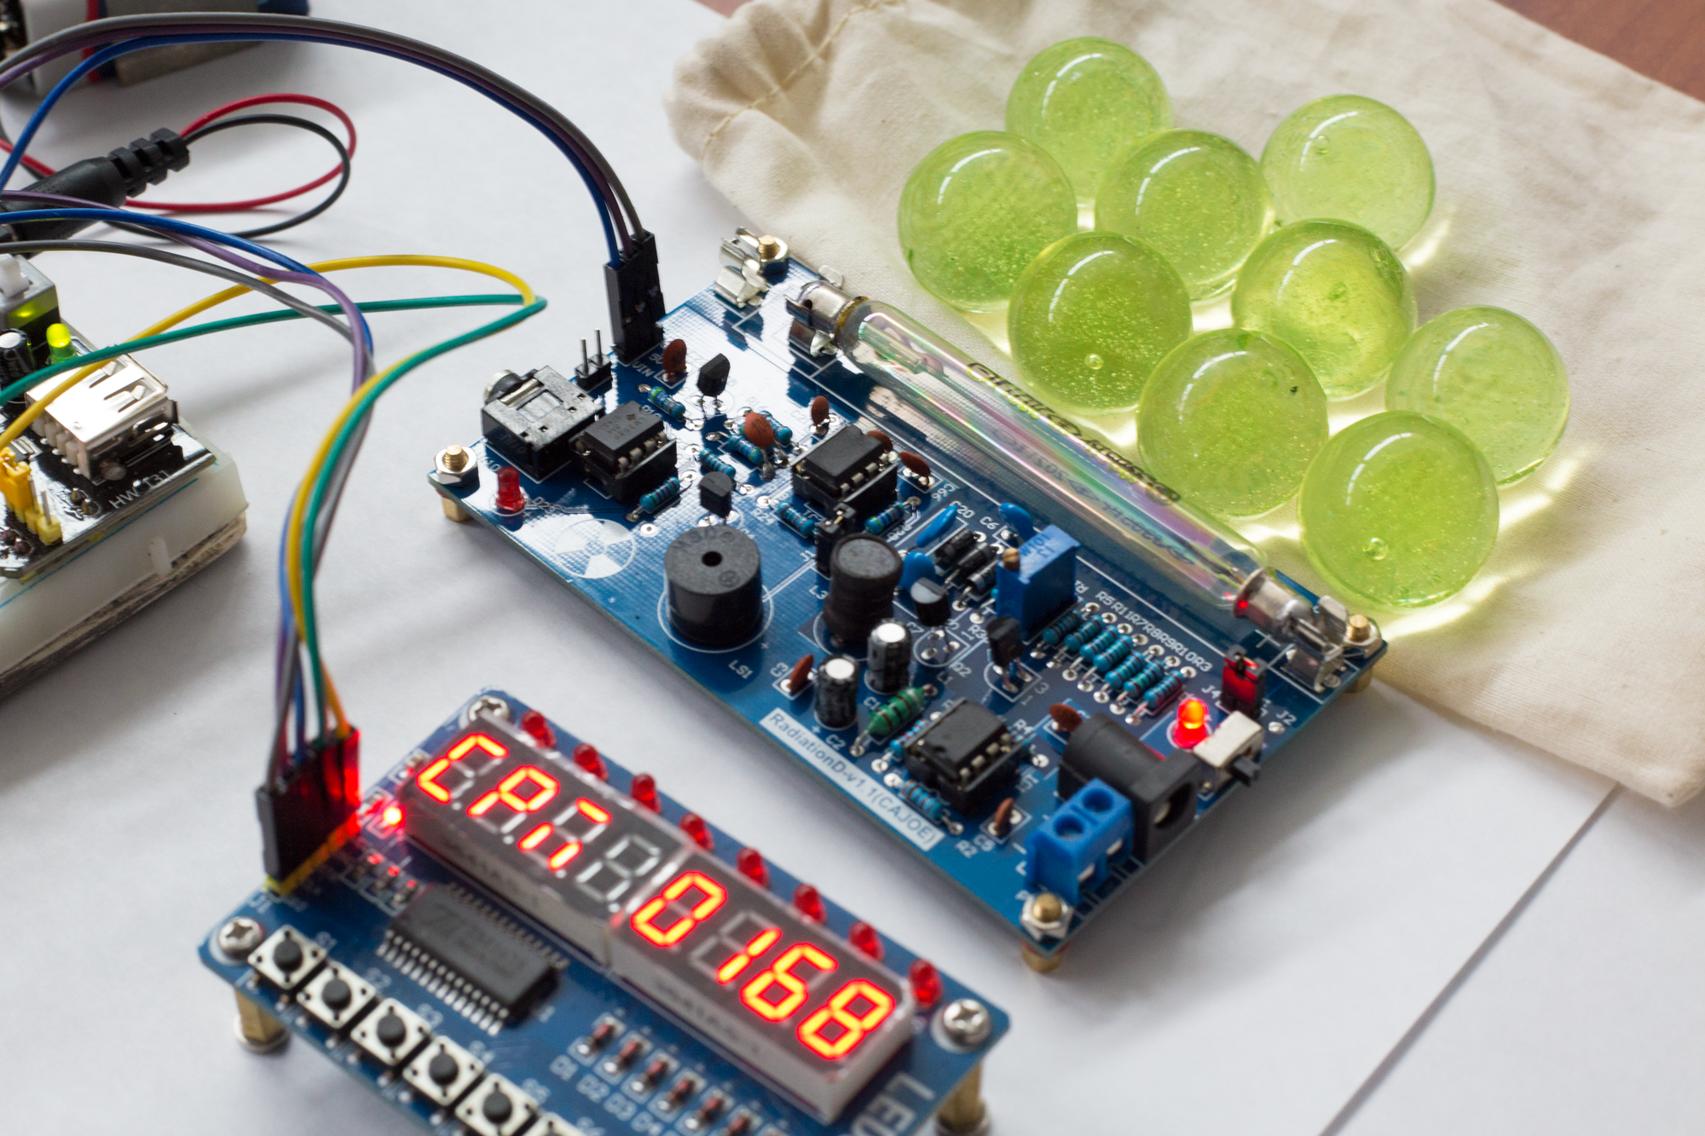
Progress Photos

Slide 18
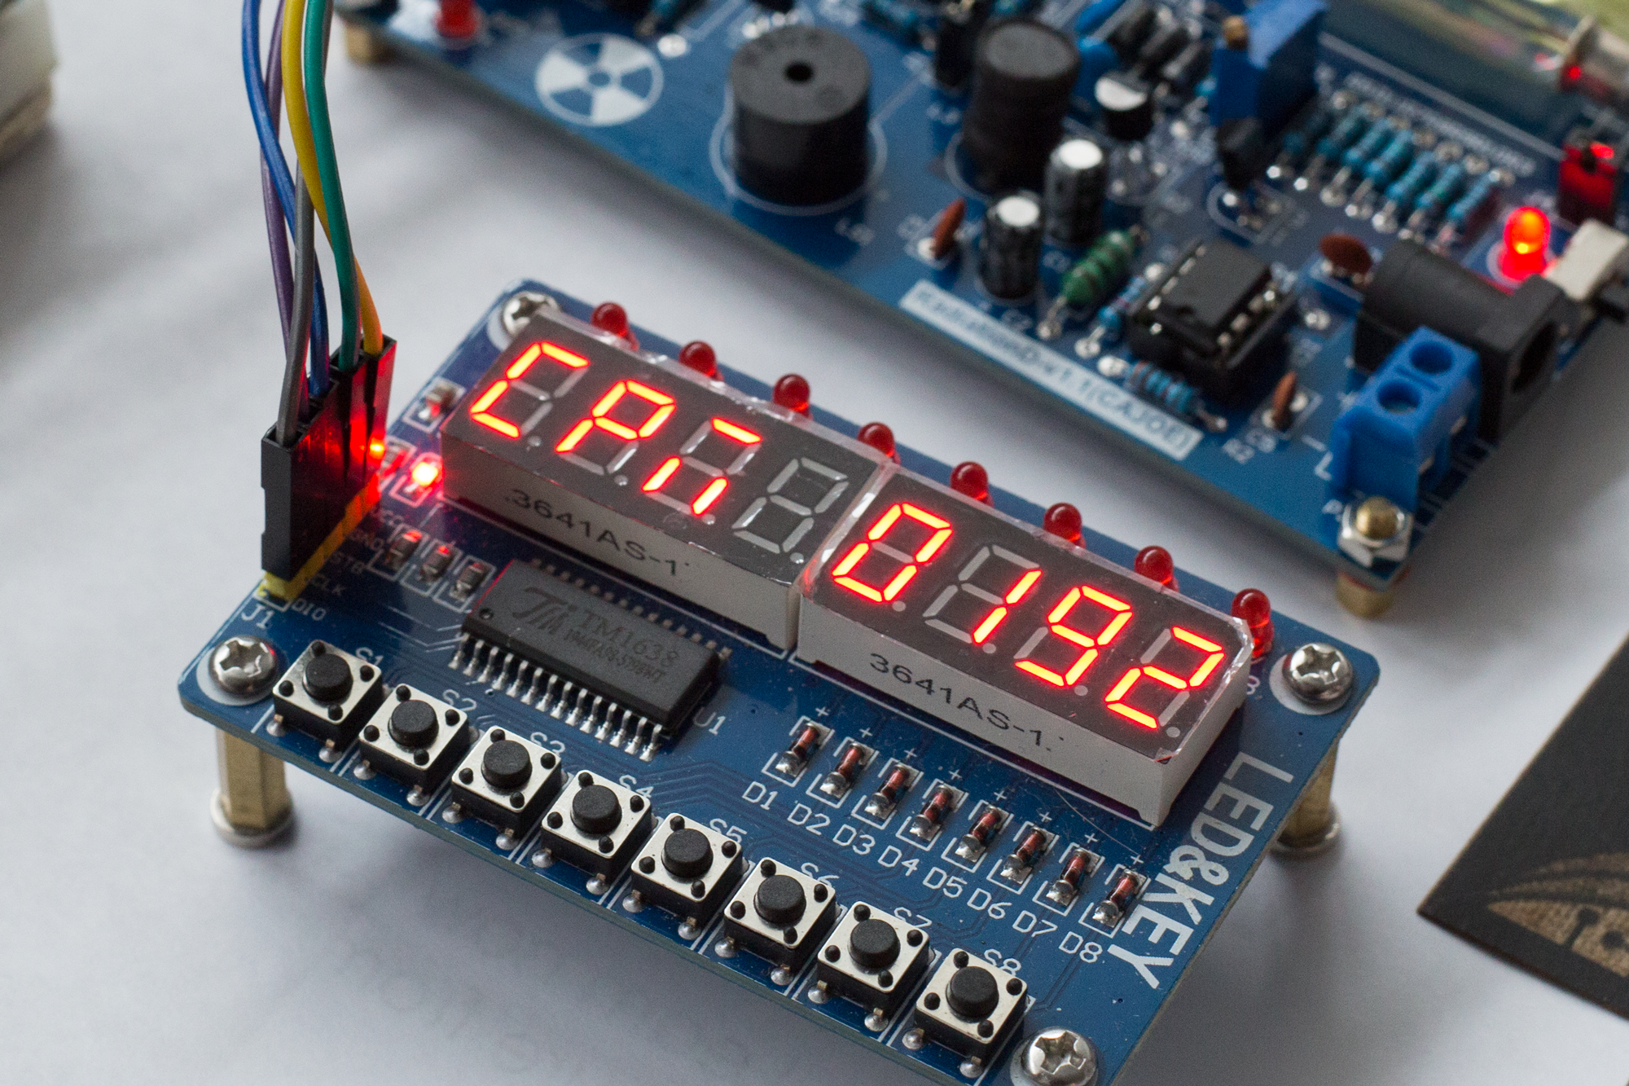
Progress Photos

Slide 19
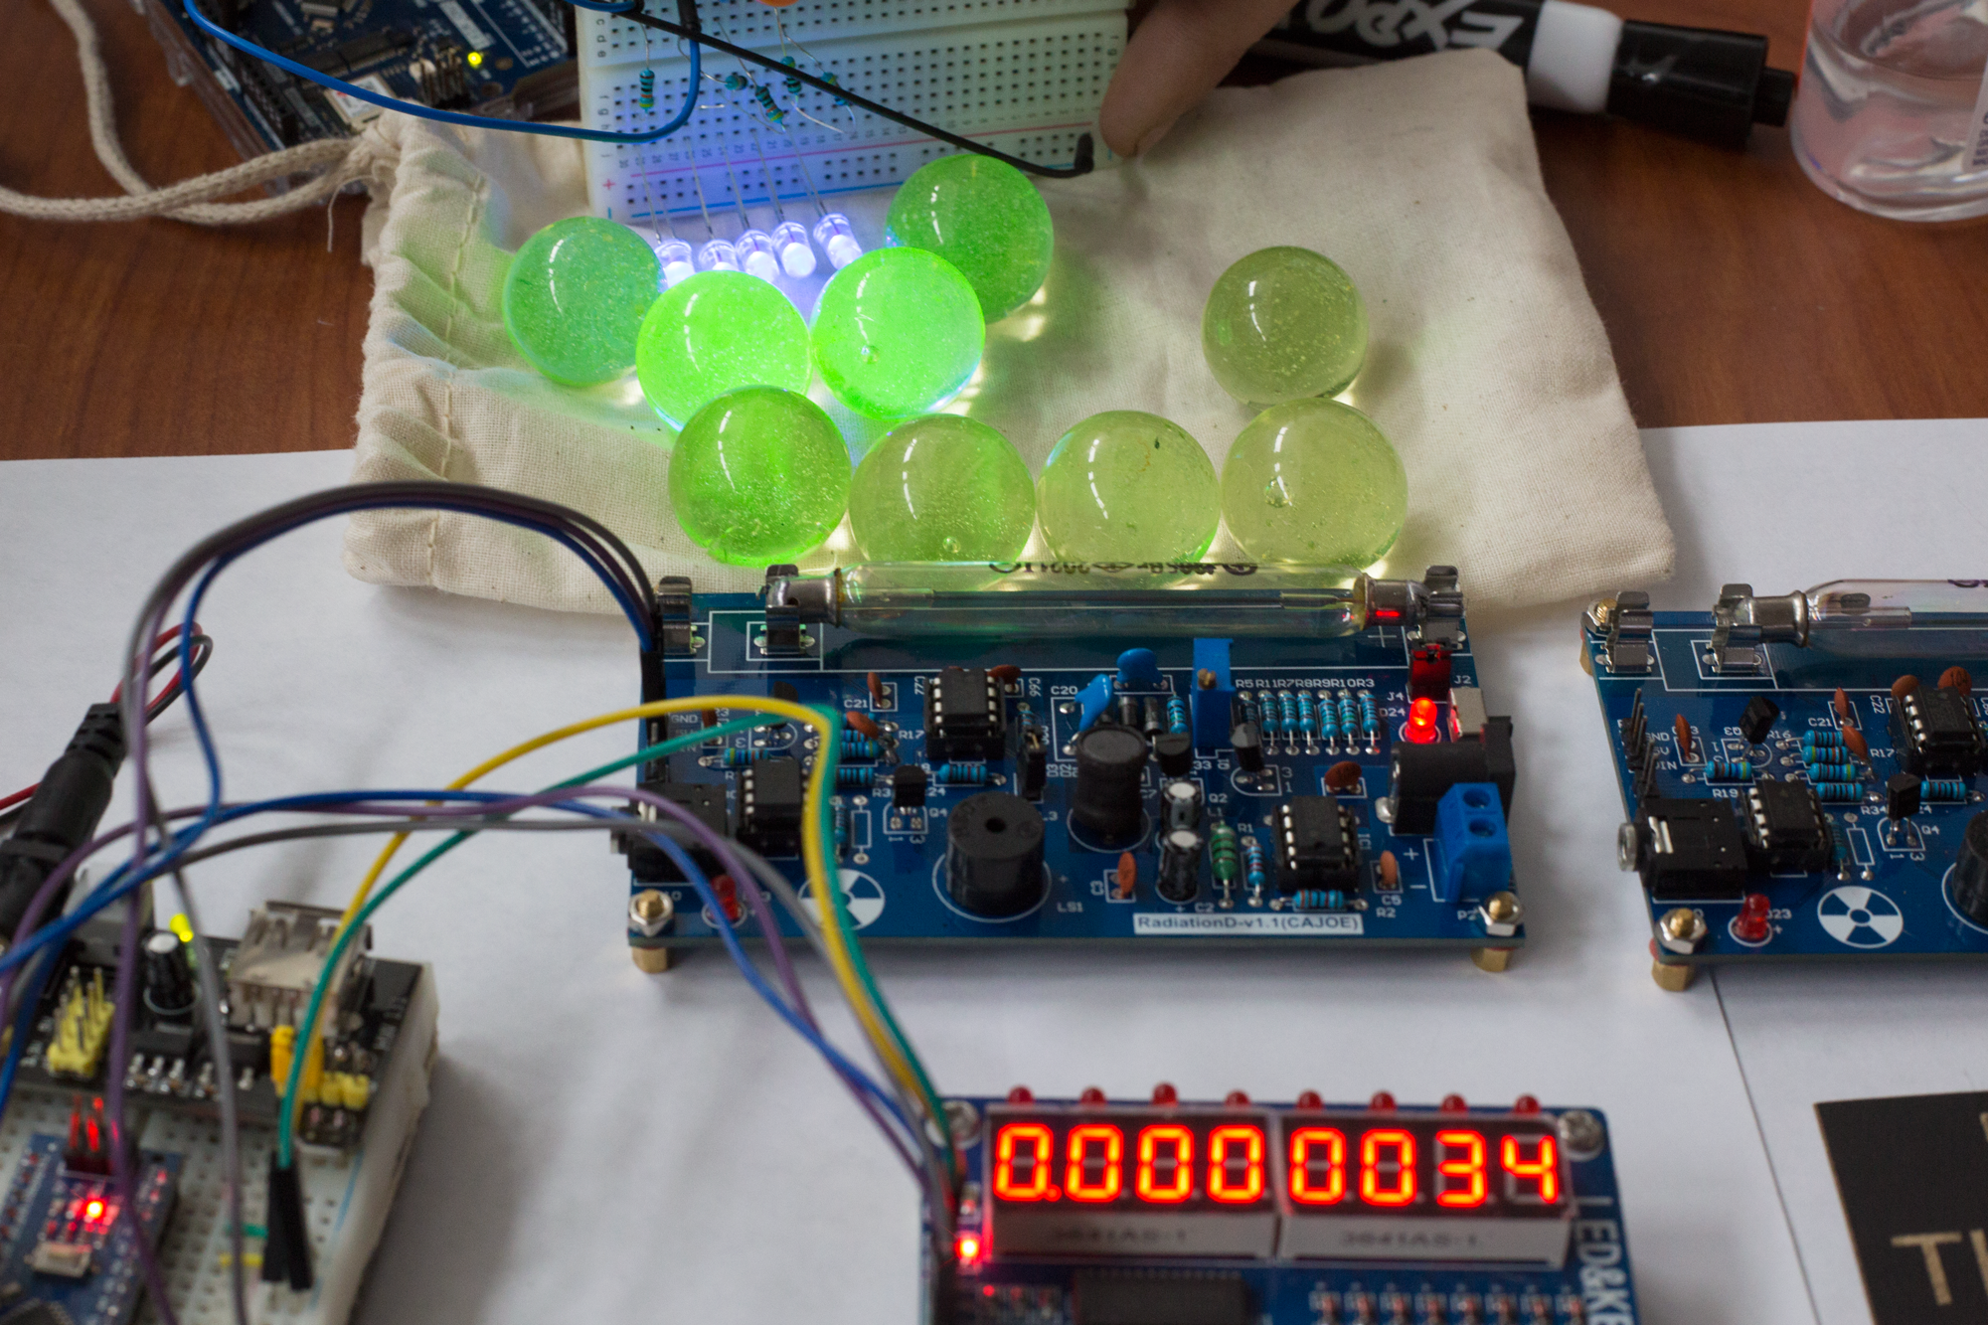
Progress Photos

Slide 20
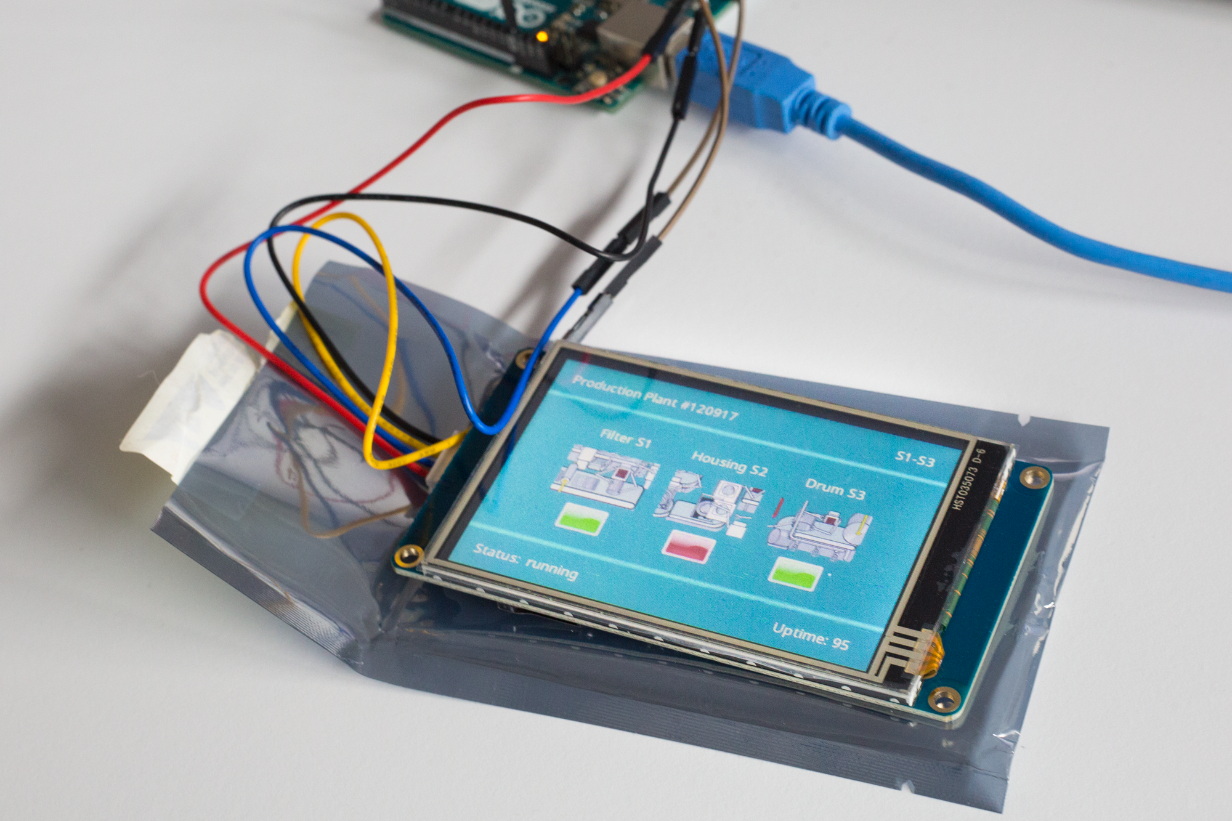
Progress Photos

Slide 21
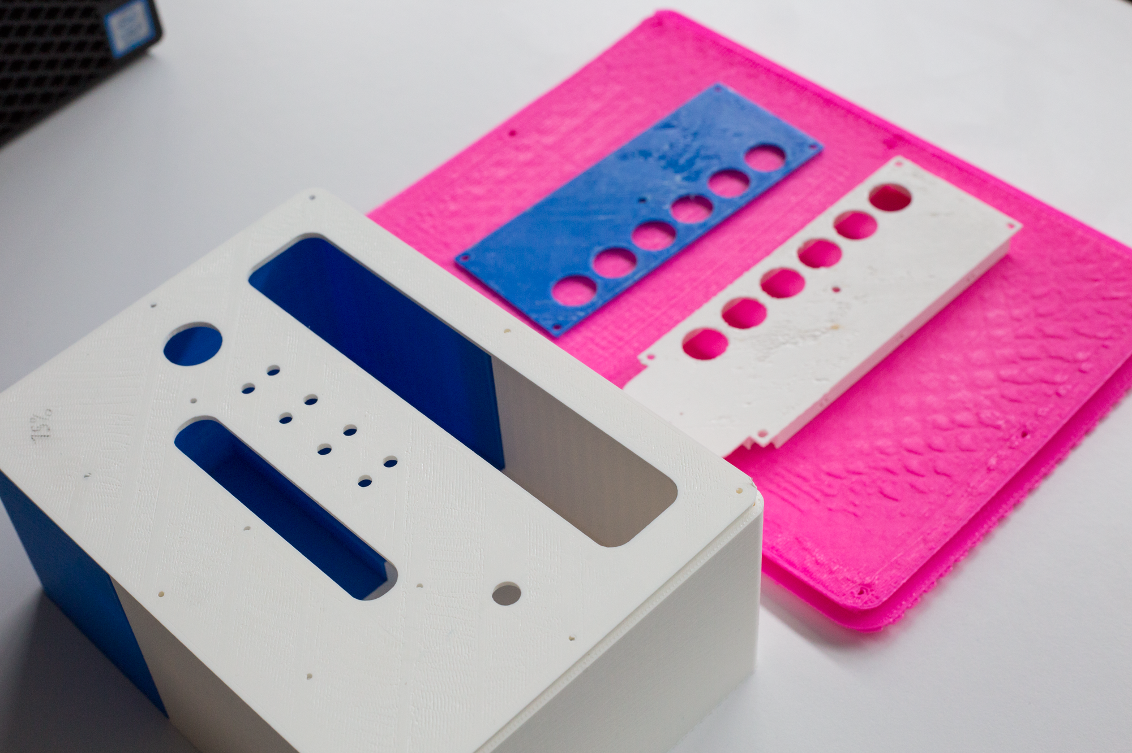
Progress Photos

Slide 22
Future Work
Statistical analysis using National Institute of Standards and Technology (NIST) Statistical Test Suite
Arduino IoT Cloud integration
Add a settings screen to change currently hard coded settings
Additional modes
Light modes
Display modes
Notes:
Kayleigh

Slide 23

Questions

Slide 24
Sources
https://github.com/northeaststatecisp/RadioactiveDice

